Slide 1

Sample Superstore | Dashboard
Salma Essam Mohamed

Slide 2
Purpose of Dashboard
Purpose :
allow C-Level management team to monitor key performance indicators (KPIs) such as profit, sales volume. These KPIs provide a snapshot of how well the sales team is performing and help identify areas that need improvement.
Provide overview on last three years and the current year with real-time data updates to react to changes in sales performance, adjust strategies, and capitalize on emerging opportunities.
visual elements like charts, graphs, and map to present complex sales data in an easy-to-understand format. This visualization makes it easier to identify trends, patterns, and anomalies within the data.
have accurate and up-to-date data presented in a dashboard so it help with decisions related to pricing, categories launches, marketing campaigns, and more can be based on data-driven.

Slide 3
methodology of Dashboard
methodology :
Determine what key performance indicators (KPIs) I want to track (profit, sales).
Identify the stakeholders who will be using the dashboard (C-Level management team).
Gather the necessary data from various sources (table order).
Design the dashboard layout and visual elements. Organize the dashboard to provide a clear overview of the sales performance.
Create visualizations for each (KPI) I want to display. Ensure that the visuals are easily understandable and visually appealing.

Slide 4
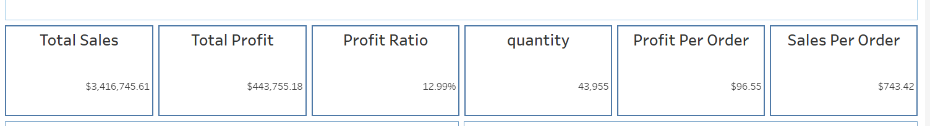
KPIS :
Total Profit: indicates the net income earned by the business ,Tracking total profit help to assess the effectiveness of the business strategies and make decisions related to cost management, pricing, and revenue generation.
Total Sales: measures the total revenue generated from selling products .It provides insights into the business's ability to attract customers and generate revenue. Tracking sales help to identify trends, measure growth, and assess the impact of marketing and sales strategies.
Profit Ratio: is the percentage of revenue that becomes profit after removing all costs . It is indicator of a business's efficiency in managing costs and generating profits from its operations.

Slide 5
Quantity: represents the total number of units of products sold. IT is useful for businesses that deal with physical products. Tracking quantity sold helps in inventory management and assessing the popularity of specific products.
Profit per Order: average profit earned from each order. Monitoring profit per order helps in evaluating the efficiency of the business's operations and identifying opportunities for cost reduction and margin improvement.
Sales per Order: (average order value) is the average amount of money customers spend in a single order. This KPI reflects the effectiveness of cross-selling, as well as the customer's willingness to purchase multiple items. Increasing the sales per order can contribute to higher revenue.

Slide 6
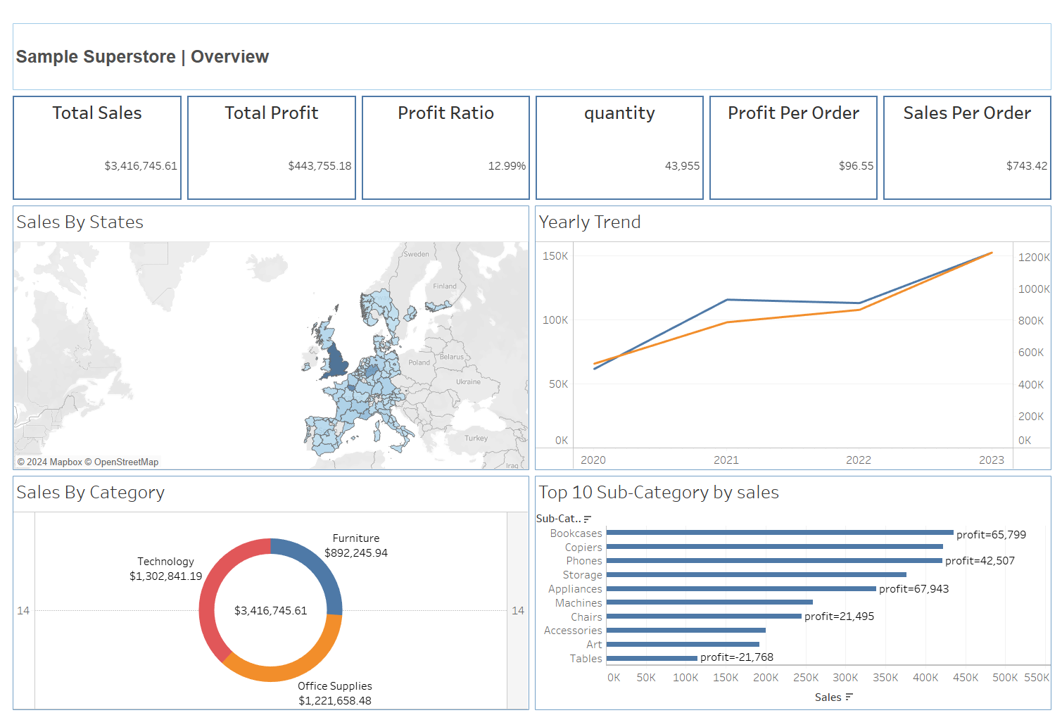
Overview

Slide 7
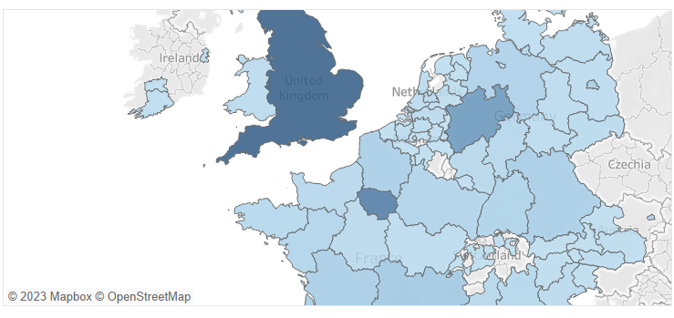
Sales By States
I used this map to help you quickly identify regions with high or low sales. This helps in understanding the geographical distribution of sales and identifying potential growth opportunities.

Slide 8
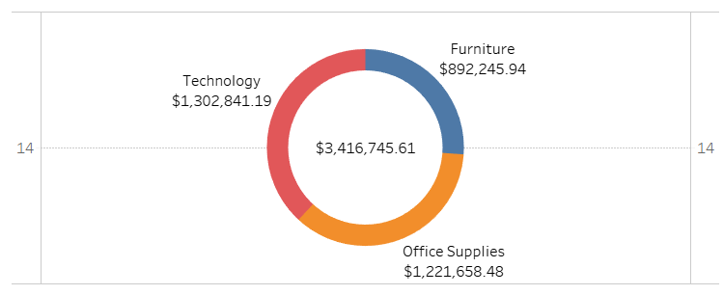
Sales By Category
I used the Donut chart to make it easy to compare the sizes of different categories. You can identify which categories have higher or lower sales with the sales volume.

Slide 9
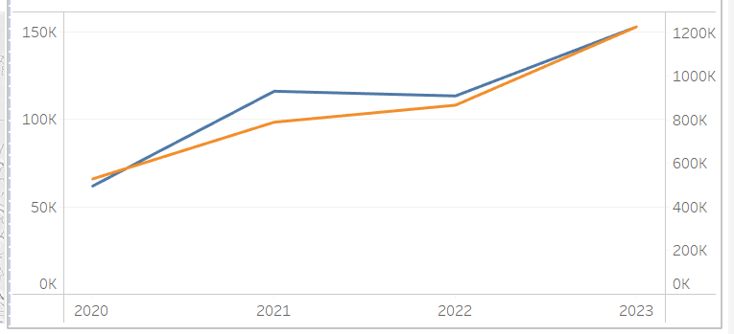
Yearly Trend
I used dual lines chart so you can understand sales and profit trend easily and compare the performance of different years. This helps in making informed decisions and strategic planning.

Slide 10
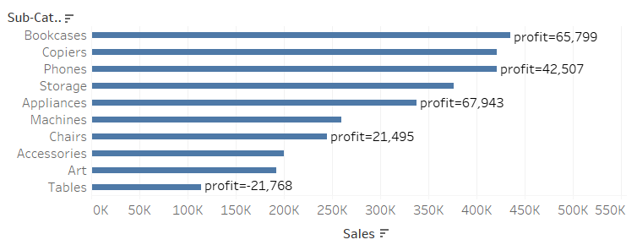
Top 10 Sub-Category By Sales
I used the horizontal bars chart to highlights the top sub-categories that generate the highest sales with the profit for each one. This information is crucial for understanding which sub-categories are popular and have a significant market demand so you can allocate marketing resources more effectively.

Slide 11

Thank you for your attention

